Slide 1
Using JavaScript in Excel
By Spencer A. Jobe

Slide 2
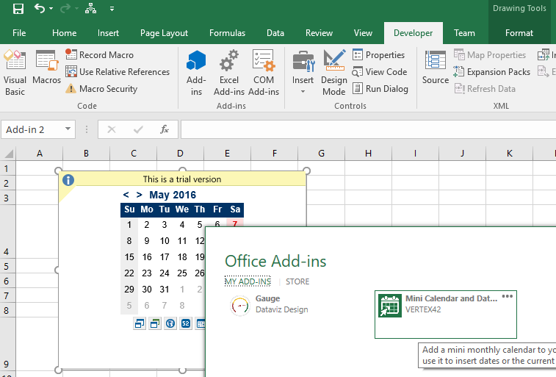
But, I’m not talking about Office Apps…
Notes:
The four event are:
active cell selection changes
active cell within a named range changes
value within a named range changes
persisted settings change.

Slide 3
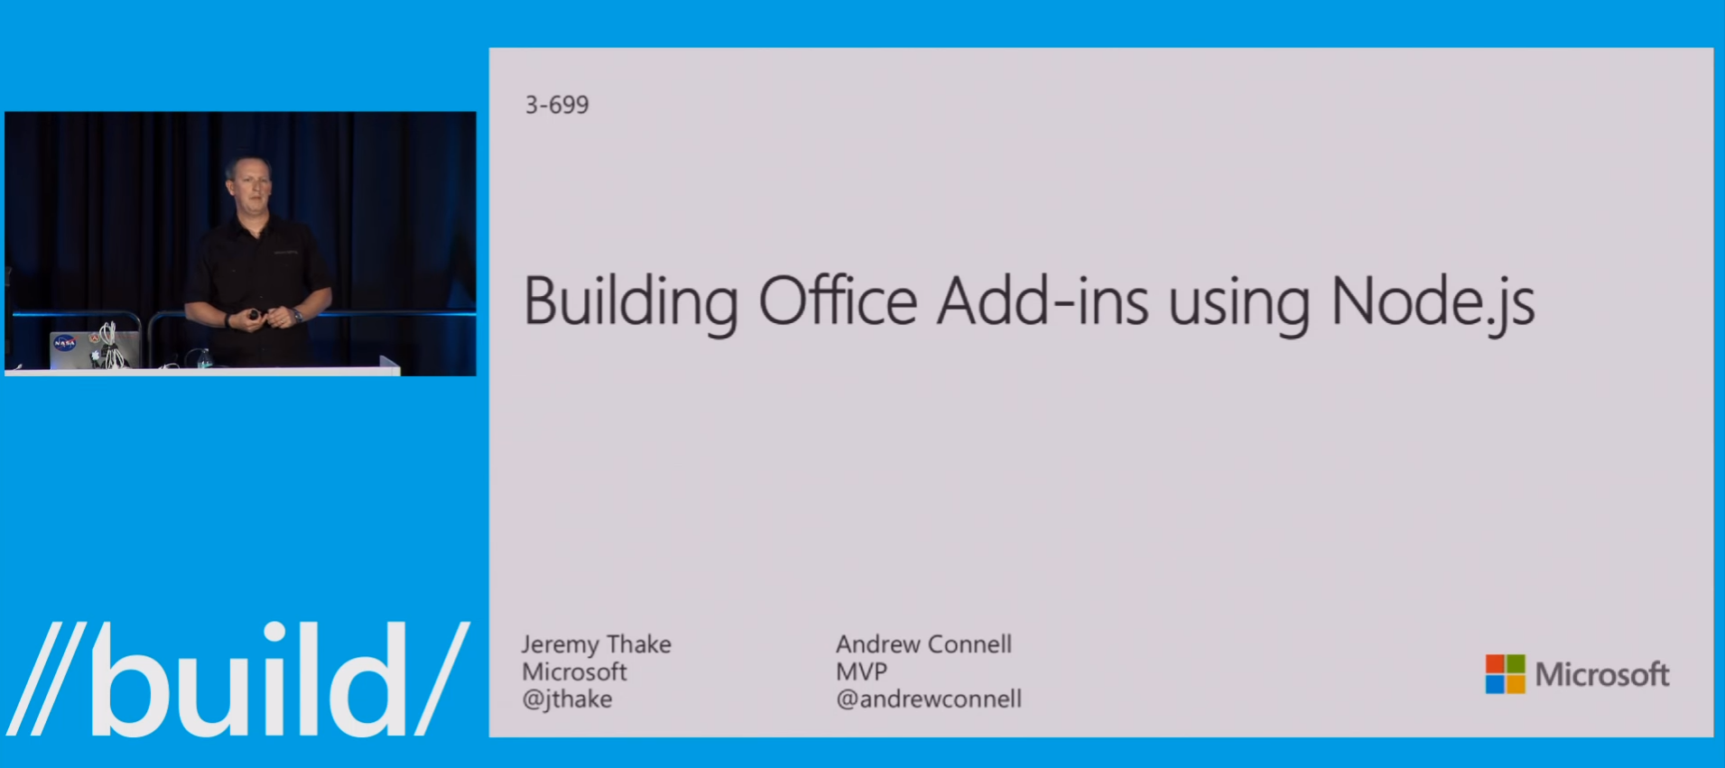
…and not Node.js and Office 365
Notes:
The four event are:
active cell selection changes
active cell within a named range changes
value within a named range changes
persisted settings change.

Slide 4
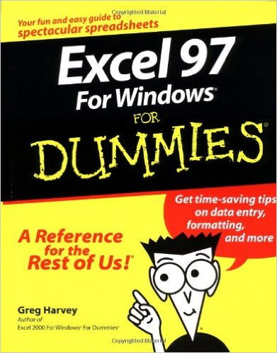
I’m Talking about old school Macros.
Notes:
The four event are:
active cell selection changes
active cell within a named range changes
value within a named range changes
persisted settings change.

Slide 5
AKA…
Notes:
The four event are:
active cell selection changes
active cell within a named range changes
value within a named range changes
persisted settings change.

Slide 6

Notes:
The four event are:
active cell selection changes
active cell within a named range changes
value within a named range changes
persisted settings change.

Slide 7
AKA…
Notes:
The four event are:
active cell selection changes
active cell within a named range changes
value within a named range changes
persisted settings change.

Slide 8
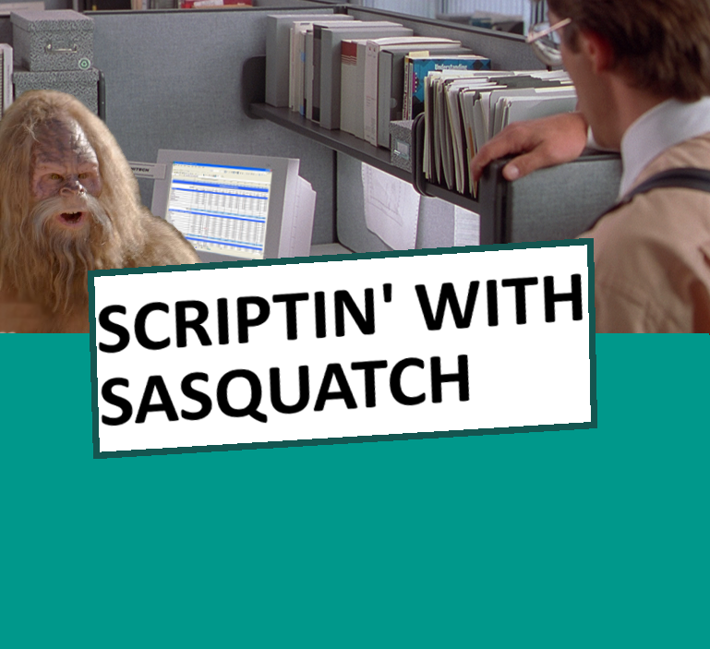

Slide 9
Simple Example: JScript from VBA
Sub Example1()
Dim Engine As Object
Set Engine = VBA.CreateObject("ScriptControl")
Engine.Language = "JScript"
Call Engine.addCode("function main() { return 'foo'; }")
Range("A1").Value = Engine.Run("main")
End Sub

Slide 10
So, what did I do with this?

Slide 11
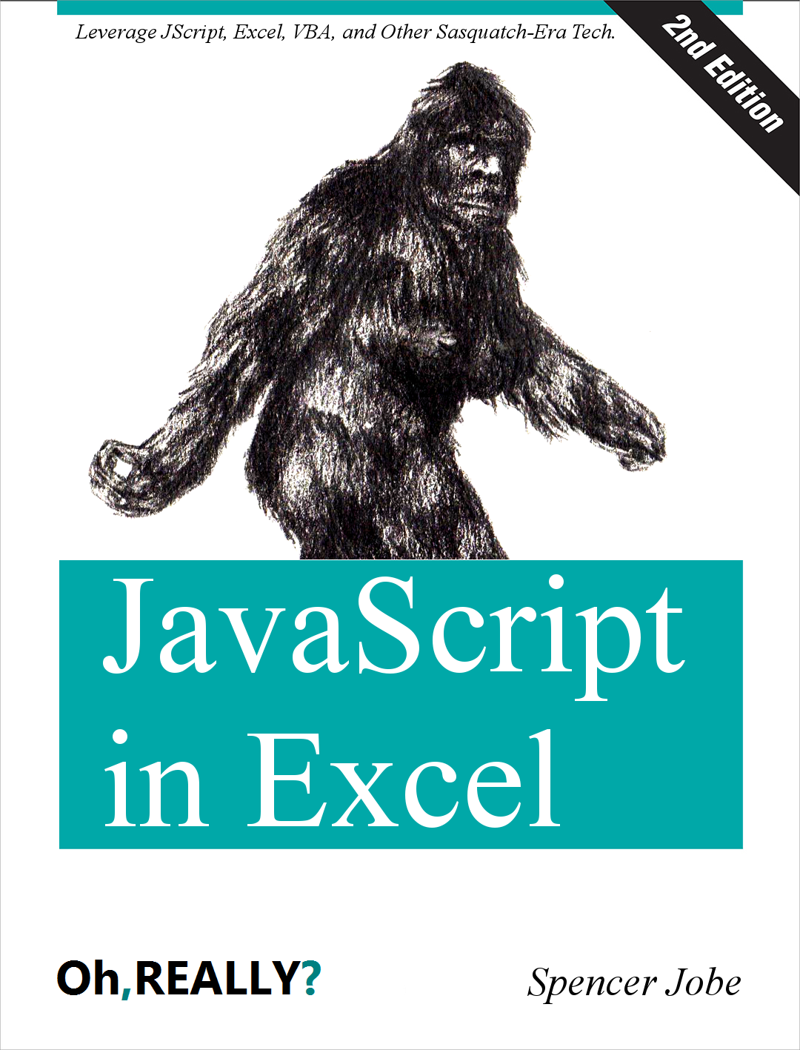

Slide 12
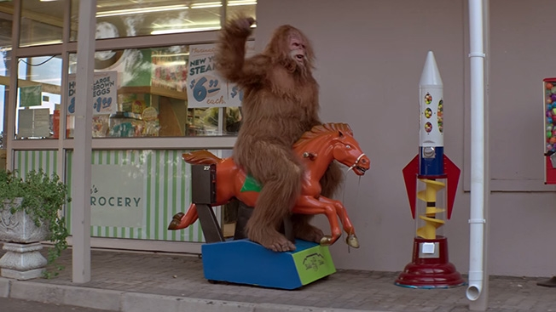
Just Kidding. Its Demo Time….

